Slide 1
Programming for Primary
Michael Emerton www.michaelemerton.co.uk
memerton@exwickheights.devon.sch.uk

Slide 2
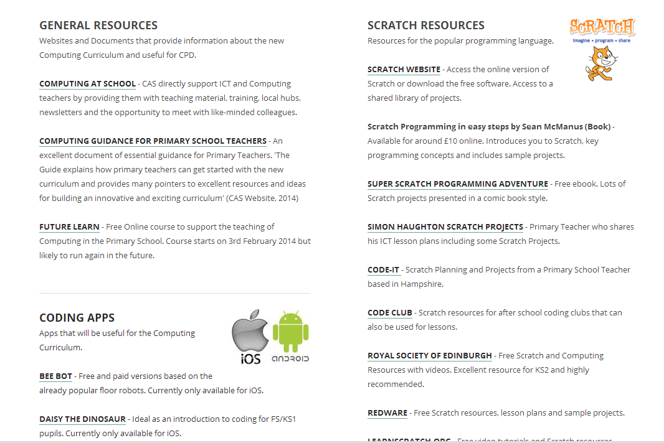
www.exwickheights.devon.sch.uk
www.michaelemerton.co.uk

Slide 3
What are we aiming for?
Questions around teaching coding.
Computing Programme of Study
What does the programme of study mean and what does this look like in the classroom?
Have a go with some resources.
Questions

Slide 5
Challenges
Computer literacy amongst educators
Training the workforce
Resources to teach coding/programming

Slide 6
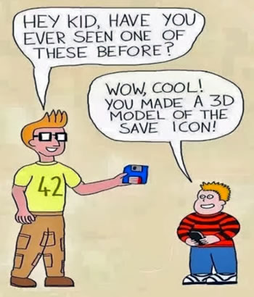
Why should we be teaching coding?
Landscape of ICT has changed whilst the curriculum and what we teach has largely remained the same.

Slide 7
Important
The new computing curriculum isn’t just about coding!
“My worry is that many schools will look at the curriculum and just interpret is as reducing the need for all of the fun creative ICT that we have been doing already.”
Ian Addison
The new curriculum allows us to keep the good aspects of ICT that we are currently teaching.

Slide 8
Don’t neglect…….
E-Safety, animation, blogging, wikis, website creation, simulations, office skills (word, spreadsheets, presentations), email, digital images, data logging etc…
Use ICT to teach skills and embed the use of these skills in to other areas of the curriculum.

Slide 9
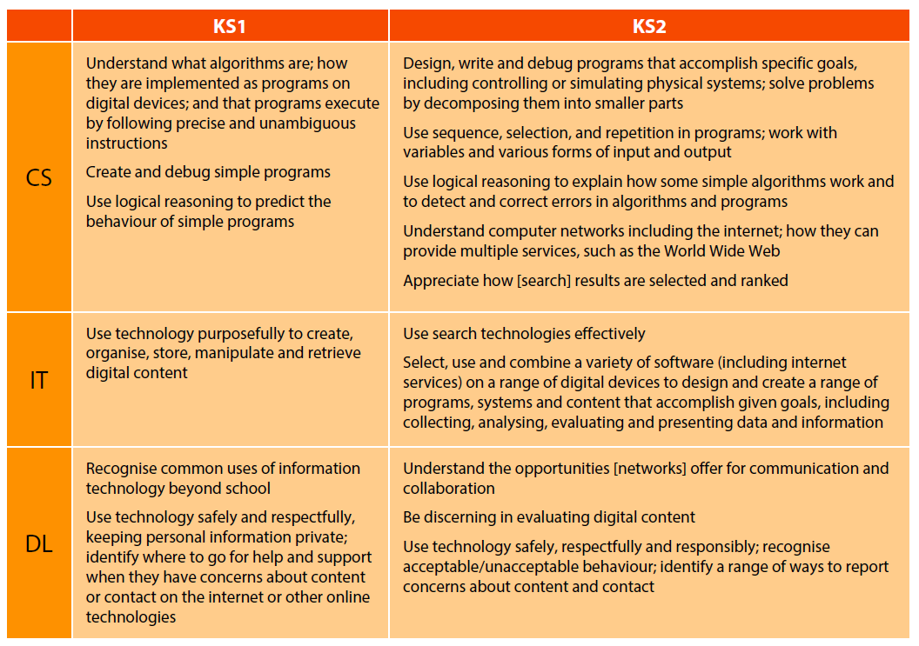
A simpler way of viewing the new Curriculum

Slide 10
Key Stage 1
Understand what algorithms are, how they are implemented as programs on digital devices, and that programs execute by following precise and unambiguous instructions.
Create and debug simple programs.
Use logical reasoning to predict the behaviour of simple programs.

Slide 11
Understanding Programme of Study statements and progression
What does that mean?
What might that look like in the classroom?

Slide 12
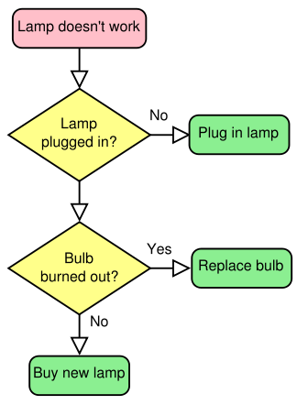
Understand what algorithms are
An algorithm is a set of instructions that perform a specific task.
Example:

Slide 13
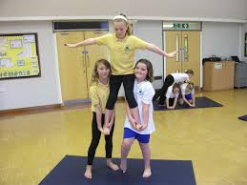
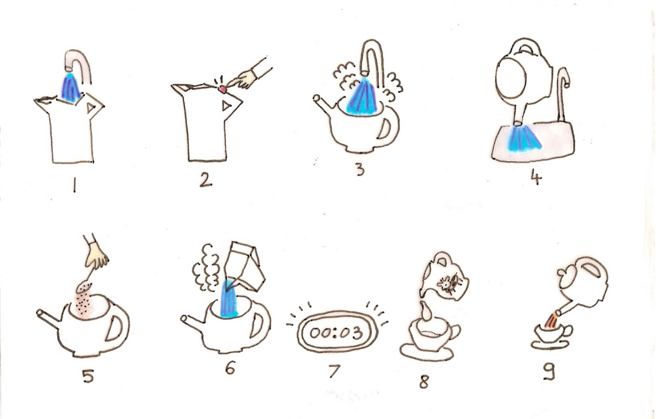
Understand what algorithms are

Slide 14
Understand what algorithms are
www.csunplugged.org

Slide 15
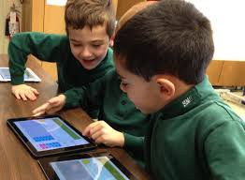
How algorithms are implemented as programs on digital devices
A programmer turns an algorithm into code using a programming language.

Slide 16
How algorithms are implemented as programs on digital devices

Slide 17
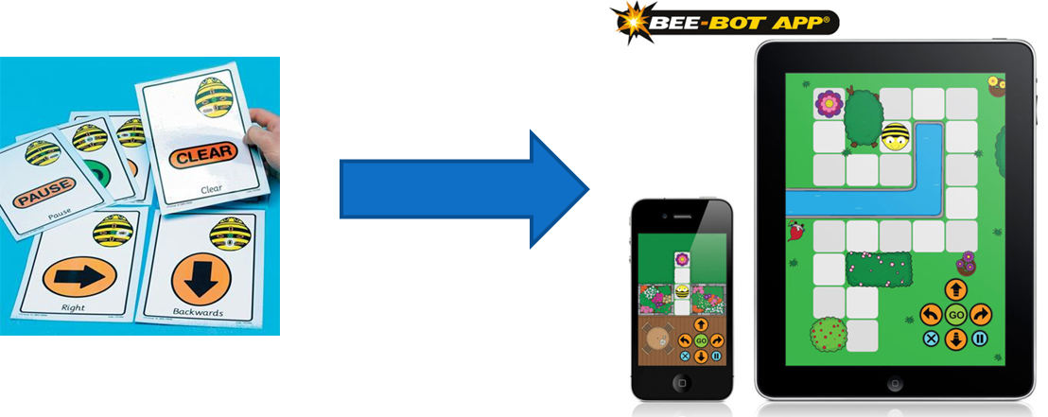
How algorithms are implemented as programs on digital devices
Resources that will help with this:
Beebots and Beebot App
Daisy the Dinosaur App
Logo
Textease Turtle

Slide 18
Programs execute by following precise and unambiguous instructions
A program will run exactly as it has been told to run even if a mistake has been made in the algorithm.
A wife asks her husband, a computer programmer, “Would you please go to the store for me and buy a carton of milk? And if they have eggs, get six.”
A short time later the husband comes back with 6 cartons of milk.
The wife asks him, “Why on Earth did you buy 6 cartons of milk?”
He replied, “They had eggs.”

Slide 20
Create and debug simple programs
Children to use algorithms to create simple programs.
Debug = problem solving. What happens when the program doesn’t work and how do we change it so that it does work?

Slide 21
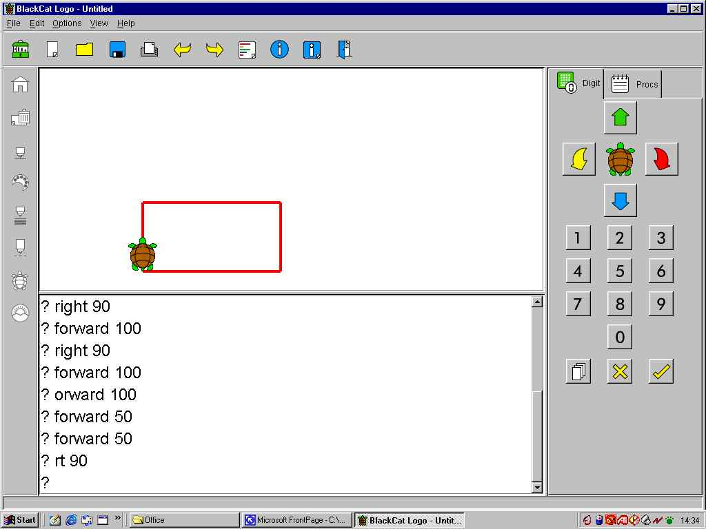
Create and debug simple programs

Slide 22
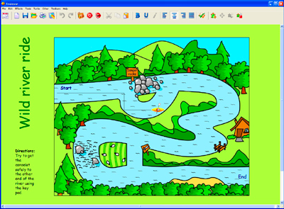
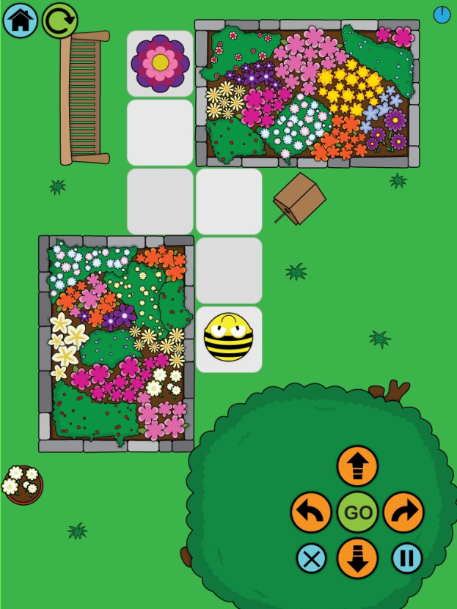
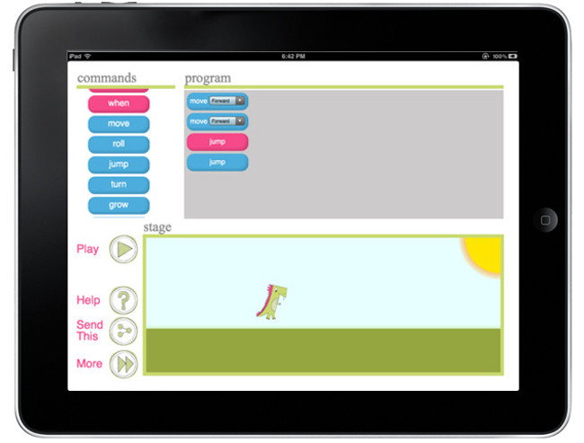
Textease Turtle
Beebot App
Daisy the Dinosaur

Slide 23
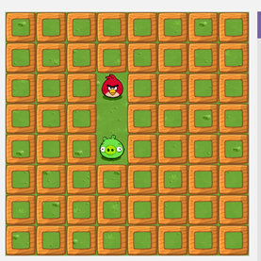
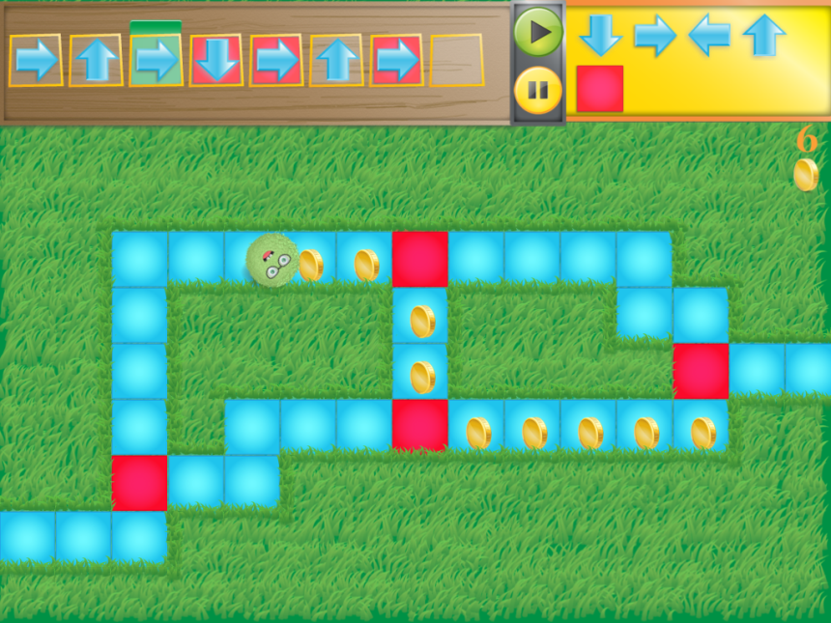
Code.org
Kodable
Debugging – Often easier when children working in pairs or discussed as a whole class.
Tynker

Slide 24
Key stage 2
Pupils should be taught to:
Design, write and debug programs that accomplish specific goals, including controlling or simulating physical systems; solve problems by decomposing them into smaller parts.
Use sequence, selection, and repetition in programs; work with variables and various forms of input and output.
Use logical reasoning to explain how some simple algorithms work and to detect and correct errors in algorithms and programs.

Slide 25
Design, write and debug programs that accomplish specific goals.
Specific aspects of coding: sequence, selection, repetition, variables, inputs and outputs.
Explain how algorithms work, detecting and correcting errors.

Slide 26
Catwalk
INPUT
REPETITION
OUTPUT

Slide 27
Frere Jacques
INPUT
REPETITION
SEQUENCING

Slide 28
Maze Game
SELECTION
IF and THEN
statements
VARIABLE

Slide 29
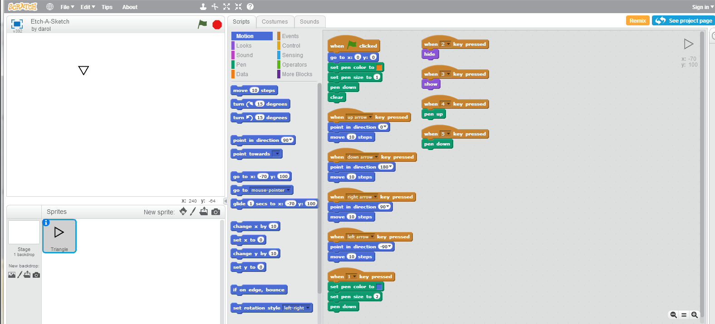
Designing Programs
Can’t design full programs unless immersed in the language.
How then can we bring in the design element throughout the curriculum?

Slide 30
Best resource to show how to teach coding.
Shows you how to teach:
How computers work
Coding Concepts
Turning an algorithm in to a program
Debugging
How to challenge more able learners

Slide 31
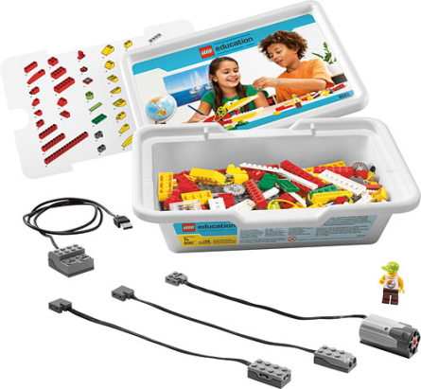
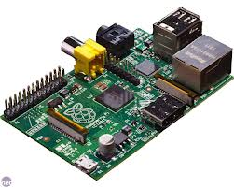
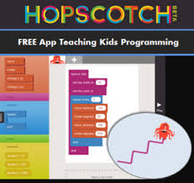
Other Resources
It is important that children learn to code using a variety of resources although it would be useful to choose one language to teach in more depth than the others.

Slide 32
Have a go with the resources!

Slide 33
Question Time

